Slide 1
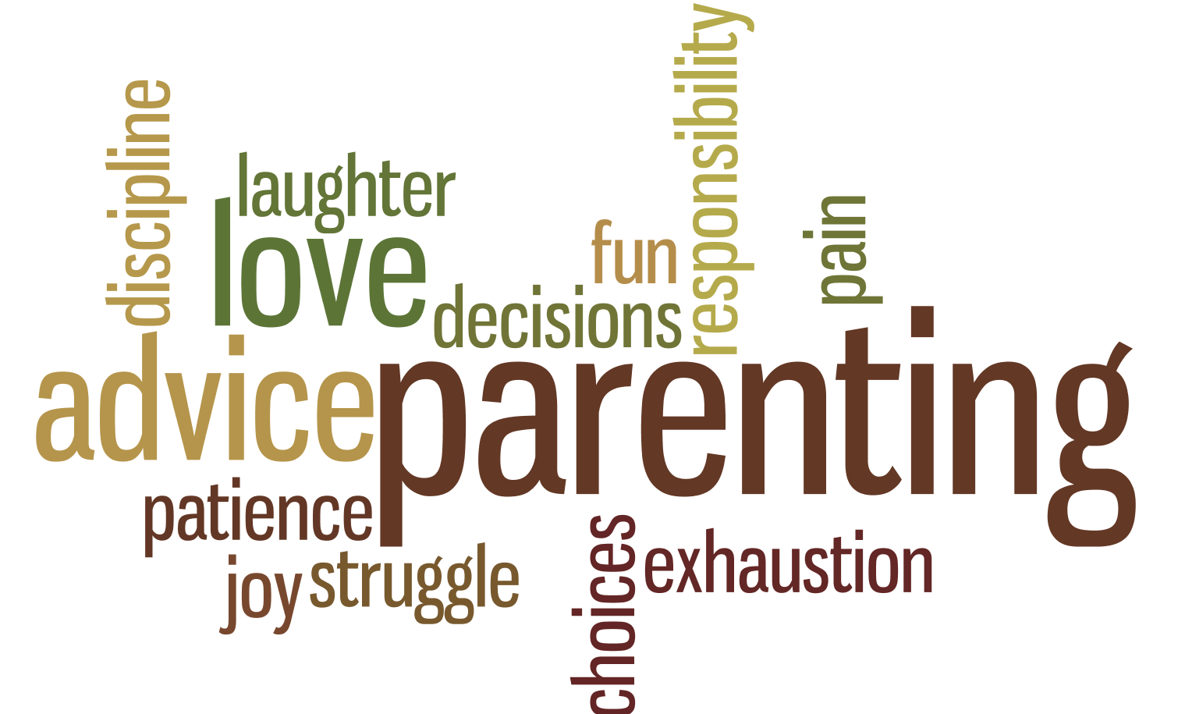
Parallel Parenting: An Intervention for High Conflict Custody Issues
Chelsea Bango, LMSW Tiffany S McLallen, LMHC
Victims Assistance Center &
Rubenzahl Knudsen and Associates

Slide 2
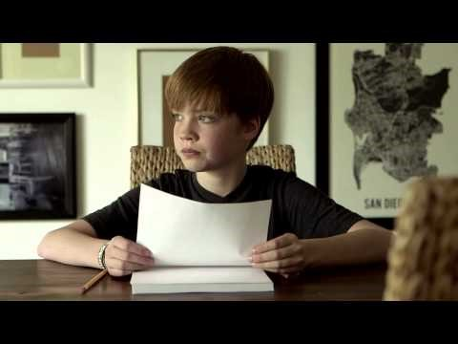
Why is intervention in high conflict divorces important?

Slide 3
Is there need in Jefferson County for High Conflict Custody Intervention?

Slide 4
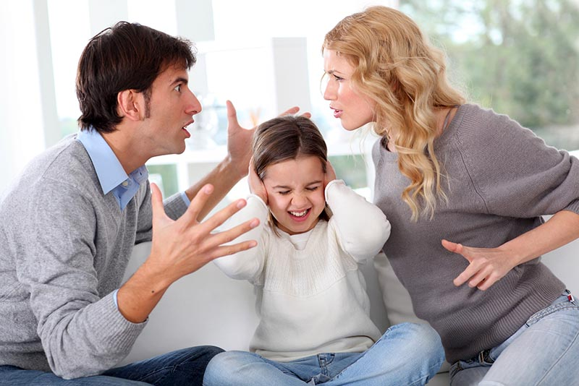
Psychological Issues That May Lead to Conflicted Parenting (Stahl)
Continuation of hostility that began during the marriage
Differing perceptions of pre-separation child-rearing roles, post-seperation child rearing roles, and how to parent.
Concern about the adequacy of the other parent’s parenting ability
Unwillingness of one or both parents to accept the end of the relationship
Jealousy about a new partner in the other parent’s life
Contested child custody issues
Personality factors in one or both parents that stimulate conflict

Slide 5
Effects of Co-Parenting Attempts in High Conflict Families
Stahl
Research shows that children who are exposed to conflict both before and following a divorce or separation experience the most significant problems.
Children develop loyalty conflicts and feel afraid to show or express love to one or both of the parents in front of the other which leads them to become aligned with one parent in an attempt to lessen anxiety or insecurity.
At its worse, there is a risk for serious psychological regression (psychological “splitting”) leading to the child seeing one parent as mostly good and the other parent as mostly bad. This reinforces a black and white view of the world rather than having an understanding that there are both good and bad within all people.
Parents with high conflict need to be able to recognize that they engage in obvious and not-so-obvious behaviors which pressure their children to have such feelings.
FRIEDBURG
40% of children in high conflict divorce develop behavior problems
Preschoolers – Anxiety and Aggressiveness
School Age – Depression, Anxiety and behavioral problems
Middle School/ High School – antisocial behavior, lower grades, social isolation, anxiety

Slide 6
Co-Parenting VS Parallel Parenting
Co-Parenting is the ideal parenting style that works best for a family where conflict is low and parents can communicate effectively in regards to their child.
They are able to discuss the needs of the child in a healthy manner, agree on most parenting values, are relatively consistent in parenting and have few arguments.
Research show that children of divorced parents are at a higher risk of developing problems with academics, relationships and substance abuse than their counterparts who grow up in non-divorced homes. However, research also shows that although at a higher risk, a majority of children in families of divorce do not show behavioral, emotional or academic problems following parental divorce. This is not a one-to-one relationship between divorce and problems within the children.
However, children exposed to conflict both during the marriage and after divorce experience the most significant problems. If the conflict continues following the divorce, children begin to exhibit more behavioral and emotional difficulties. -(Stahl)

Slide 7
Personality and Behaviors that can lead to high conflict (Stahl)
Continuation of hostility that began during the marriage
Differing perceptions of pre-separation child rearing roles
Differing perceptions of post-separation child rearing roles
Differing perceptions of how to parent
Concern about the adequacy of the other parentis parenting ability
An unwillingness of one or both parents to accept the boundaries of the end of their relationship
Jealousy about a new partner in the other parent’s life
Contested custody issues
Personality factors in one or both parents that stimulate conflict

Slide 8
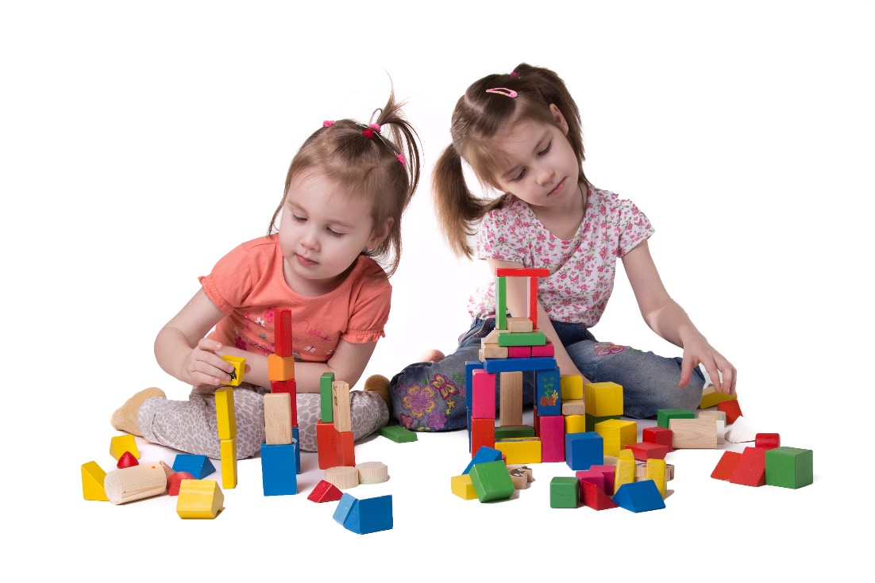
Parallel Parenting: What Is It? (Stahl)
Helps families who experience moderate to high levels of conflict that the children are caught in the middle of.
One or both parents’ inability to separate new parent roles from old partner roles significantly contributes to the conflict between the parents.
Uses a 2 step process to reduce conflict levels between the parents.
Style of parenting where both parents learn how to effectively parent their child.
Parents are not engaged with one another to avoid conflicts.
Compared to parallel play such as in toddlers.

Slide 9
Goals of Parallel Parenting
Offer an alternative intervention for highly conflicted co-parents, where mediation and co-parenting are not in the best interest of the child
1
Create child-specific, concrete parenting structures within and between the child’s multiple environments
2
Create and identify the boundaries necessary for separate environments, while limiting efforts of other caregiver to impose control outside of their environment
3
Allow for the healthiest form of communication possible to maintain
4
Child-Parent relationship is the forefront of the decision making not the parental dynamics
5

Slide 10
Role of the Facilitator (GARBER)
Personality Characteristic within the Role
Maintain a child centered approach to decision making
Exercise creativity and flexibility
Sets and models healthy boundaries/limits to participants
Does not determine who is right or wrong
Addresses deficits in communication and while avoiding interpersonal conflicts in becoming the target of manipulation, anger and shifting alliances.
Steps Facilitator will take to determine interventions and bring focus to interventions that will best meet the child’s needs
A. Assess the strengths and weaknesses of the participants, including the child, through review of social, emotional, educational, developmental assessments. This includes collateral assessments and direct observation.
Assessment of the resources available to the child in each caregiving enviornemnt
Establish child-specific boundaries, limits and routine in the two (or more) caregiving environments

Slide 11
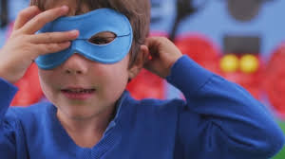
CASE STUDY – What level of intervention is appropriate?
STUDY 1
Parents: Batman and Robin
Child: Catboy
6 months ago parents became separated. It is reported that Batman was always working and Robin always felt alone in raising the Catboy. Robin would constantly call him and make comments to Catboy when he was gone that Batman thinks work is more important than family. When Batman is home the Catboy enjoys spending time with him, playing video games, kayaking, etc. Robin does not work outside the home but enjoys going out with friends on the weekends. Batman and Robin will often verbally argue at home, and they think Catboy is not listening. The arguments will end with either police involvement or one person leaving the home. On the night that Batman left from the separation, Catboy was confused because he did not return.
Appropriate Interventions
Interview with the parents individually.
Interview the child.
Score Assessment form
Is Parallel Parenting appropriate?

Slide 12
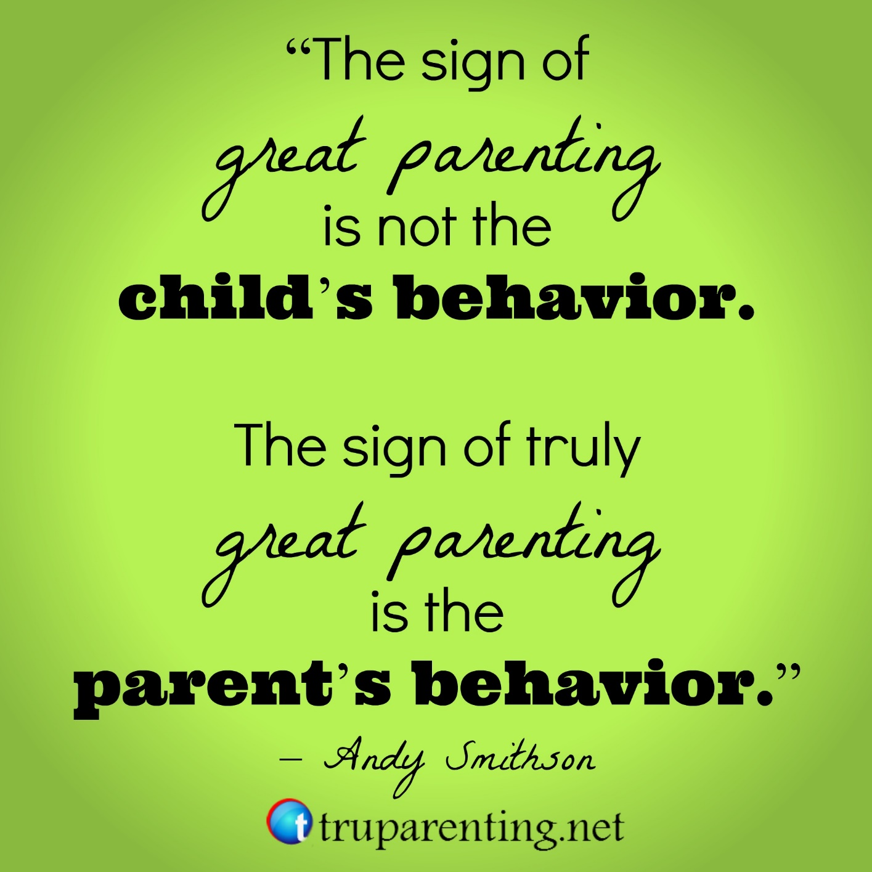
QUESTIONS AND COMMENTS

